Slide 1

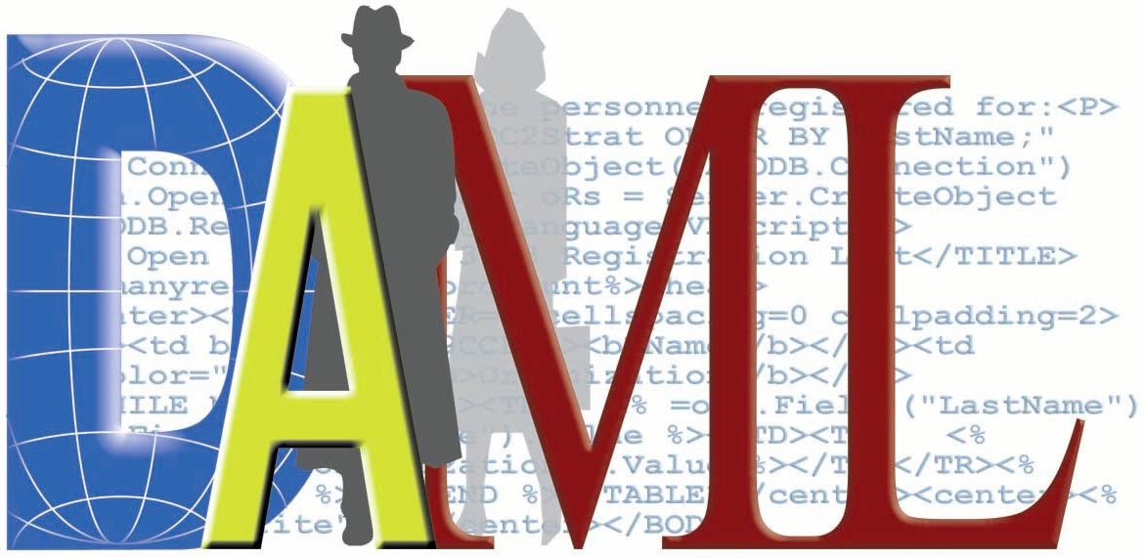
Designing Ontologies with DAML+OIL
Based on tutorials and presentations:
M. Burke, J. Flynn, D. De Roure, A. Jain, S.A. McIlraith, J. Hobbs, D. Connolly, T. Payne, F.V. Harmelen, I. Horrocks, D.L. McGuinness, P.F. Patel-Schneider, L.A. Stein, UMBC, …

Slide 2



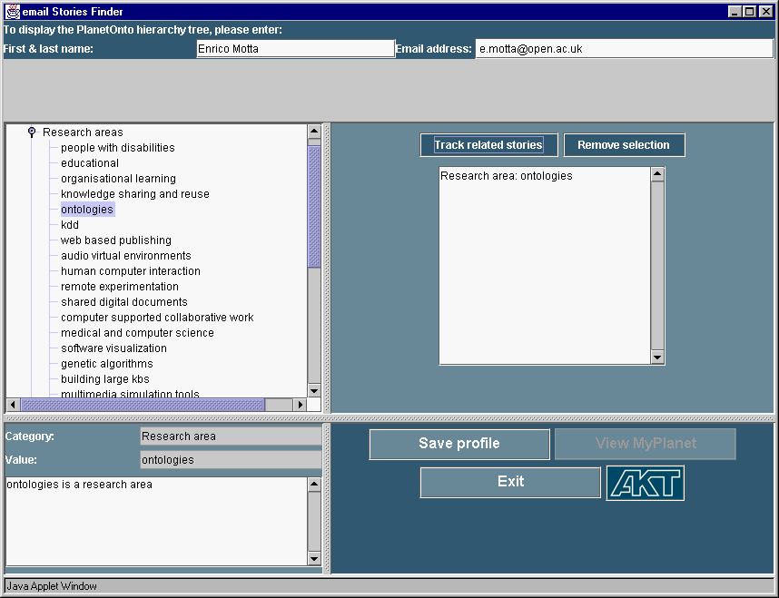
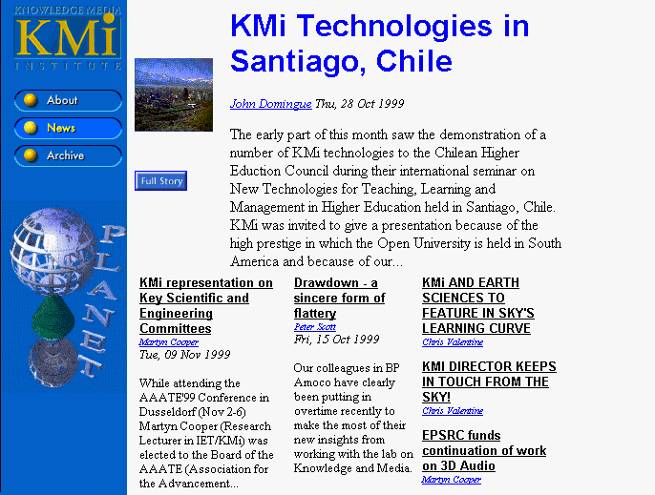

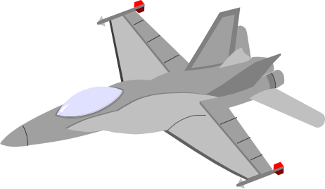
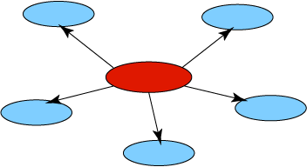
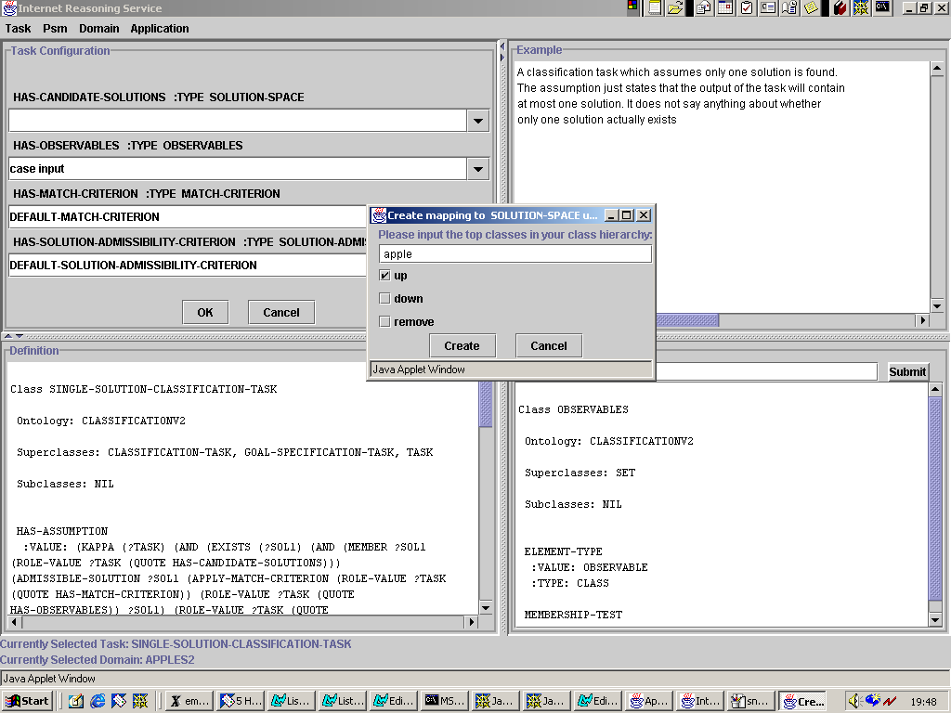
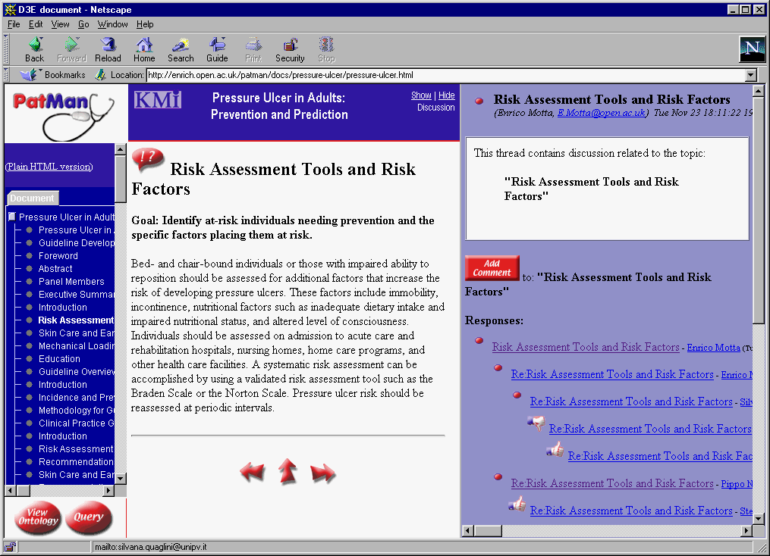
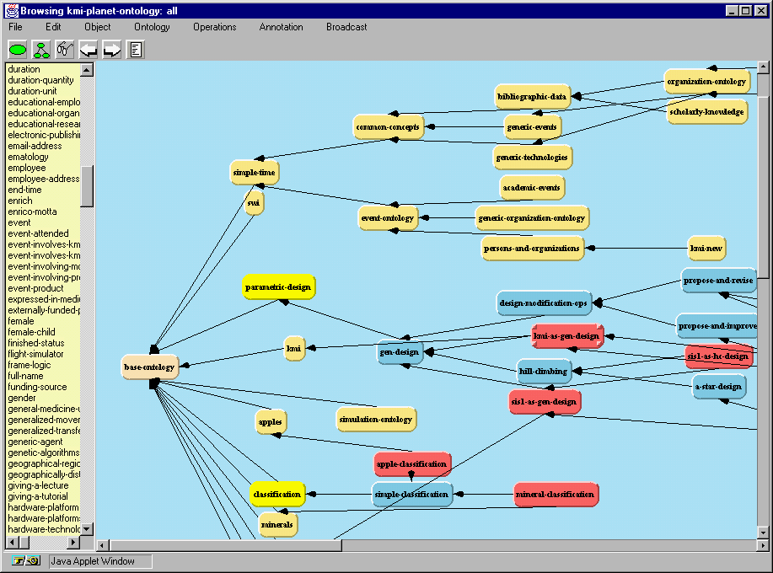
Dynamic Identification and Understanding of the Information Sources in the Web - are among the basic abilities of an intelligent agent

Slide 3

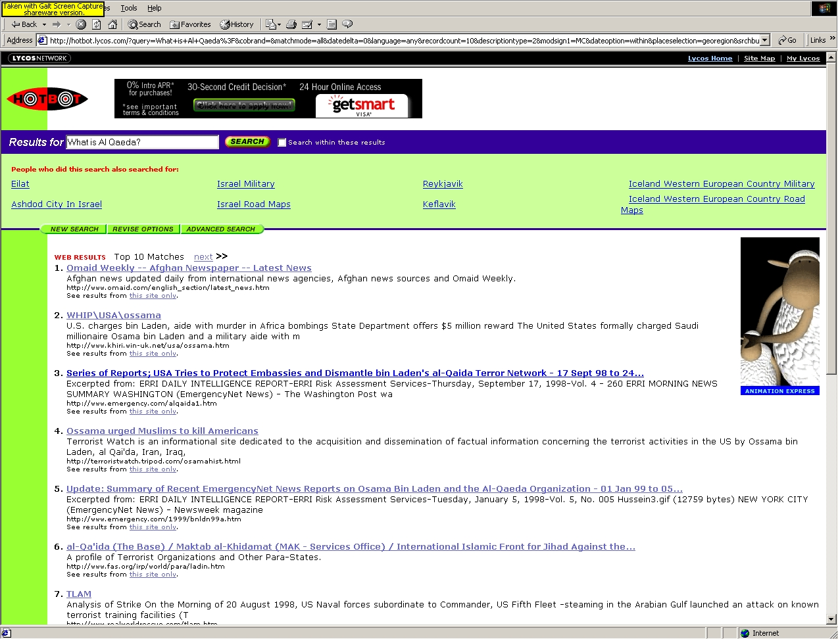

Query Today
WWW Hotbot
What is Al Qaeda?
The answer may be
somewhere in this
list of URLs

Slide 4
Semantic Query
What is Al Qaeda?
A terrorist organization
Would you like additional information on?
Membership
Locations
Structure
Finances
Tactics
Other terrorist organizations

Slide 5
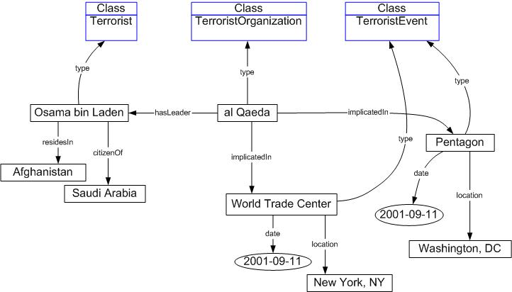

Example Ontology
These ontologies accessed at remote locations

Slide 6

Agent-Based Inferencing
<daml:Class rdf:ID=“Bin Laden">
<rdfs:subClassOf rdf:resource="#terrorist"/>
</daml:Class>
Implies
If x is Bin Laden, he must be a terrorist
If x is a terrorist, then he may or may not be Bin Laden
If x is not a terrorist, then he is not Bin Laden
If x is not Bin Laden, he may or may not be a terrorist

Slide 7
Developing the Language
Formal Logics
Knowledge Representation
Reasoning
AI Community
European
OIL Community
Local
Environments
DARPA
DAML
DAML + OIL
US – EU
DAML Joint
Committee
WWW
Environment
HTML
XML
RDF
W3C
Web
Standards
WebOnt
WG

Slide 8
Precedents
1995 . . . . . . . . . . . . . . . . . . . . .1998
2000 . . . . . . . . . . . . . . . . . . . . 2003
Dozens of application design languages
Dozens of knowledge representation languages
Rumbaugh
Booch
Odell
KREME
Loom
RDF
Rational
Rose
Paradigm
Plus
KEE
KIF
OMG
DARPA / W3C
UML
DAML
One modeling language
One Web KR language

Slide 9
Motivation for DAML+OIL
W3C’s (world wide web consortium) Semantic Web:
- RDF and metadata markup efforts to represent data in
a machine understandable form.
DARPA (Defence Advanced Research Projects Agency)
started the DARPA Agent Markup Language (DAML)
program. Since they started the ARPANET, and funded the Web,
they wanted to be involved with the Semantic Web as well.
EC (European Commission) came up with the Ontology
Interchange Language (OIL)
- logic based language.
- brings logic and inference to the Semantic Web

Slide 10
DAML.org
DARPA, EC, W3C joined forces to make the DAML+OIL language.
It builds on earlier W3C standards such as RDF and RDF Schema.
DAML extends RDF and RDFS with richer modeling primitives.
(Examples : disjointWith, intersectionOf, oneOf, cardinality)
Able to provide properties of properties (uniqueness, transitivity, etc.)
Current version DAML+OIL provides a semantic interpretation (model-theoretic semantics) for the schema defined in daml+oil.daml
The details on the language can be found at :
http://www.daml.org/2001/03/daml+oil-index.html

Slide 11
Language Structure
A DAML+OIL ontology is made up of several components, some of which are optional, and some of which may be repeated.
A DAML+OIL ontology consists of zero or more headers, followed by zero or more class elements, property elements, and instances.

Slide 12
Header
An daml:Ontology element contains zero or more version information and imports elements.
<Ontology rdf:about="">
<versionInfo>$Id: NOTE-daml+oil-reference-20011218.html,v 1.6
2001/12/18 22:12:09 connolly Exp $</versionInfo>
<rdfs:comment>An example ontology</rdfs:comment>
<imports rdf:resource="http://www.w3.org/2001/10/daml+oil"/>
</Ontology>
The daml:versionInfo element
generally contains a string
giving information about this version
daml:imports statement references
another DAML+OIL ontology
containing definitions that
apply to the current DAML+OIL
resource.

Slide 13
Objects and Datatype Values
DAML+OIL divides the universe into two disjoint parts. One part consists of the values that belong to XML Schema datatypes. This part is called the datatype domain. The other part consists of (individual) objects that are considered to be members of classes described within DAML+OIL (or RDF). This part is called the object domain.
DAML+OIL is mostly concerned with the creation of classes that describe (or define) part of the object domain. Such classes are called object classes and are elements of daml:Class, a subclass of rdfs:Class.

Slide 14
Class Elements (1)
A class element, daml:Class. A class element refers to a class name (a URI), (we will refer to this class as C) and contains:
  zero or more rdfs:subClassOf elements (each containing a class-expression). Each subClassOf element asserts that C is a subclass of the class-expression mentioned in the element. Each class-expression defines a (possibly anonymous) class;

Slide 15
Class Elements (2)
A class element, daml:Class. A class element refers to a class name (a URI), (we will refer to this class as C) and contains:
  zero or more daml:disjointWith elements (each containing a class-expression). Each disjointWith element asserts that C is disjoint with the class-expression in the element (ie. C must have no instances in common with it);

Slide 16
Class Elements (3)
A class element, daml:Class. A class element refers to a class name (a URI), (we will refer to this class as C) and contains:
  zero or more daml:disjointUnionOf elements (each containing a list of class-expressions). Each disjointUnionOf element asserts that C has the same instances as the disjoint union of the class-expressions element. More precisely: all of the classes defined by the class-expressions of a disjointUnionOf element must be pairwise disjoint (i.e. there can be no individual that is an instance of more than one of the class expressions in the list.), and their union must be equal to C;

Slide 17
Class Elements (4)
A class element, daml:Class. A class element refers to a class name (a URI), (we will refer to this class as C) and contains:
  zero or more daml:sameClassAs elements (each containing a class-expression). Each sameClassAs element asserts that C is equivalent to the class-expression in the element (ie. C and all the class-expression must have the same instances);

Slide 18
Class Elements (5)
A class element, daml:Class. A class element refers to a class name (a URI), (we will refer to this class as C) and contains:
  zero or more daml:equivalentTo elements (each containing a class expression). When applied to a class, the equivalentTo element has the same semantics as the sameClassAs element;

Slide 19
Class Elements (6)
A class element, daml:Class. A class element refers to a class name (a URI), (we will refer to this class as C) and contains:
  zero or more boolean combinations of class expressions.
  The class C must be equivalent to the class defined by each of the Boolean class expression;
  zero or more enumeration elements. Each enumeration element asserts that C contains exactly the instances enumerated in the element (i.e: no more, no less).

Slide 20
Class Expressions (1)
A class expression is the name used in this document for either
  a class name (a URI);
  an enumeration, enclosed in <daml:Class>...</daml:Class> tags;
  a property-restriction;
  a boolean combination of class expressions, enclosed in <rdfs:Class>...</rdfs:Class> tags.

Slide 21
Class Expressions (2)
Each class expression either refers to a named class, namely the class that is identified by the URI, or implicitly defines an anonymous class, respectively the class that contains exactly the enumerated elements, or the class of all instances which satisfy the property-restriction, or the class that satisfies the boolean combination of such expressions.
Two class names are already predefined, namely the classes daml:Thing and daml:Nothing. Every object is a member of daml:Thing, and no object is a member daml:Nothing. Consequently, every class is a subclass of daml:Thing, and daml:Nothing is a subclass of every class.

Slide 22
Enumerations
An enumeration is a daml:oneOf element, containing a list of the objects that are its instances. This enables defining a class by enumerating its elements. The class defined by the oneOf element contains exactly the enumerated elements, no more, no less. For example:
<daml:oneOf parseType="daml:collection">
<daml:Thing rdf:about="#Eurasia"/>
<daml:Thing rdf:about="#Africa"/>
<daml:Thing rdf:about="#North_America"/>
<daml:Thing rdf:about="#South_America"/>
<daml:Thing rdf:about="#Australia"/>
<daml:Thing rdf:about="#Antarctica"/>
</oneOf>

Slide 23
Property Restrictions (1)
A property restriction is a special kind of class expression. It implicitly defines an anonymous class, namely the class of all objects that satisfy the restriction. There are two kinds of restrictions:
  ObjectRestriction, works on object properties, i.e., properties that relate objects to other objects;
  DatatypeRestriction, works on datatype properties, i.e., properties that relate objects to datatype values.

Slide 24
Property Restrictions (2)
A daml:Restriction element contains an daml:onProperty element, which refers to a property name (a URI) (we will refer to this property as P) and one or more of the following:
  daml:toClass element (which contains a class expression ).
  A toClass element defines the class of all objects for whom the values of property P all belong to the class expression. In other words, it defines the class of object x for which it holds that if the pair (x,y) is an instance of P, then y is an instance of the class-expression or datatype;

Slide 25
Property Restrictions (3)
A daml:Restriction element contains an daml:onProperty element, which refers to a property name (a URI) (we will refer to this property as P) and one or more of the following:
  daml:hasValue element (which contains (a reference to) an individual object or a datatype value). A hasValue element defines the class of all objects for whom the property P has at least one value equal to the named object or datatype value (and perhaps other values as well). In other words, if we call the instance y, then it defines the class of objects x for which (x,y) is an instance of P;

Slide 26
Property Restrictions (4)
A daml:Restriction element contains an daml:onProperty element, which refers to a property name (a URI) (we will refer to this property as P) and one or more of the following:
  daml:hasClass element (which contains a class expression or a datatype references). A hasClass element defines the class of all objects for which at least one value of the property P is a member of the class expression or datatype. In other words, it defines the class of objects x for which there is at least one instance y of the class-expression or datatype such that (x,y) is an instance of P. This does not exclude that there are other instances (x,y') of P for which y' does not belong to the class expression or datatype;

Slide 27
Property Restrictions (5)
A daml:Restriction element contains an daml:onProperty element, which refers to a property name (a URI) (we will refer to this property as P) and one or more of the following:
  daml:cardinality element. This defines the class of all objects that have exactly N (cardinality restriction - non negative integer) distinct values for the property P, i.e. x is an instance of the defined class if and only if there are N distinct values y such that (x,y) is an instance of P;

Slide 28
Property Restrictions (6)
A daml:Restriction element contains an daml:onProperty element, which refers to a property name (a URI) (we will refer to this property as P) and one or more of the following:
  daml:maxCardinality element. This defines the class of all objects that have at most N distinct values for the property P;
  daml:minCardinality element. This defines the class of all objects that have at least N distinct values for the property P;

Slide 29
Property Restrictions (7)
A daml:Restriction element contains an daml:onProperty element, which refers to a property name (a URI) (we will refer to this property as P) and one or more of the following:
  daml:cardinalityQ element. This defines the class of all objects that have exactly N distinct values for the property P that are instances of the class expression or datatype (and possibly other values not belonging to the class expression or datatype). In other words: x is an instance of the defined class (x satisfies the restriction) if and only if there are exactly N distinct values y such that (x,y) is an instance of P and y is an instance of the class expression or datatype;

Slide 30
Property Restrictions (8)
A daml:Restriction element contains an daml:onProperty element, which refers to a property name (a URI) (we will refer to this property as P) and one or more of the following:
  daml:maxCardinalityQ element. This defines the class of all objects that have at most N distinct values for the property P that are instances of the class expression or datatype (and possibly other values not belonging to the class expression or datatype);
  daml:minCardinalityQ element. This defines the class of all objects that have at least N distinct values for the property P that are instances of the class expression or datatype (and possibly other values not belonging to the class expression or datatype).

Slide 31
Boolean Combination of Class Restrictions
daml:intersectionOf element, containing a list of class expressions. This defines the class that consists of exactly all the objects that are common to all class expressions from the list. It is analogous to logical conjunction;
daml:unionOf element, containing a list of class expressions.
This defines the class that consists exactly of all the objects that belong to at least one of the class expressions from the list. It is analogous to logical disjunction;
daml:complementOf element, containing a single class expression. This defines the class that consists of exactly all objects that do not belong to the class expression. It is analogous to logical negation, but restricted to objects only.

Slide 32
Property Elements
A rdf:Property element refers to a property name (a URI) (to which we will refer as P). Properties that are used in property restrictions should be either properties, which relate objects to other objects, and are instances of:
  ObjectProperty;
  DatatypeProperty.

Slide 33
Content of a Property Element (1)
zero or more rdfs:subPropertyOf elements, each containing a property name. Each subPropertyOf element states that P is a subproperty of the property named in the element. This means that every pair (x,y) that is an instance of P is also an instance of the named property;
zero or more rdfs:domain elements (each containing a class expression). Each domain element asserts that the property P only applies to instances of the class expression of the element. More formally: if a pair (x,y) is an instance of P, then x is an instance of the class expression. This implies that multiple domain expressions restrict the domain of P to the intersection of the class expressions.

Slide 34
Content of a Property Element (2)
zero or more rdfs:range elements (each containing a class expression). Each range element asserts that the property P only assumes values that are instances of the class expression of the element. More formally: a pair (x,y) can only be an instance of P if y is an instance of the class expression;
zero or more daml:samePropertyAs elements (each containing a property name). Each samePropertyAs element asserts that P is equivalent to the named property (i.e. they must have the same instances);
zero or more equivalentTo elements (each containing a property name). When applied to a property, the equivalentTo element has the same semantics as the samePropertyAs element;

Slide 35
Content of a Property Element (3)
zero or more daml:inverseOf elements (each containing a property name), for properties only. Each inverseOf element asserts that P is the inverse relation of the named property. More formally: if the pair (x,y) is an instance of P, than the pair (y,x) is an instance of the named property;
daml:TransitiveProperty element, which is a subclass of ObjectProperty. This asserts that P is transitive, i.e: if the pair (x,y) is an instance of P, and the pair (y,z) is an instance of P, then the pair (x,z) is also an instance of P;

Slide 36
Content of a Property Element (4)
daml:UniqueProperty element. This asserts that P can only have one (unique) value y for each instance x, i.e: there cannot be two distinct instances y1 and y2 such that the pairs (x,y1) and (x,y2) are both instances of P. Of course, this is a shorthand notation for the maxCardinality restriction of 1;
daml:UnambigousProperty element, which is a subclass of ObjectProperty. This asserts that an instance y can only be the value of P for a single instance x, i.e: there cannot be two distinct instances x1 and x2 such that both (x1,y) and (x2,y) are both instances of P. Notice that the inverse property of a UniqueProperty is always an UnambigousProperty and vice versa.

Slide 37
Instances
Instances of both classes (i.e., objects) and of properties (i.e., pairs) are written in RDF and RDF Schema syntax. For example:
<continent rdf:ID="Asia"/>
<rdf:Description rdf:ID="Asia">
<rdf:type>
<rdfs:Class rdf:about="#continent"/>
</rdf:type>
</rdf:Description>
<rdf:Description rdf:ID="India">
<is_part_of rdf:resource="#Asia"/>
</rdf:Description>

Slide 38
Datatype Values
Datatype values are written in a manner that is valid RDF syntax, but which is given a special semantics in DAML+OIL. The preferred method is to give a lexical representation of the value as a string, along with an XML Schema datatype that is used to provide the type of the value as well as the parsing mechanism to go from the string to the value itself.
The XML Schema datatype is the rdf:type of the value, and the lexical representation is the rdf:value of the value.
For example decimal 10.5 could be input as:
<xsd:decimal rdf:value="10.5">

Slide 39
Examples (1)
There are two types of animals, Male and Female.
<rdfs:Class rdf:ID="Male">
<rdfs:subClassOf rdf:resource="#Animal"/>
</rdfs:Class>
The subClassOf element asserts that its subject - Male - is a subclass of its object -- the resource identified by #Animal.
<rdfs:Class rdf:ID="Female">
<rdfs:subClassOf rdf:resource="#Animal"/>
<daml:disjointWith rdf:resource="#Male"/>
</rdfs:Class>
Some animals are Female, too, but nothing can be both Male and Female (in this ontology) because these two classes are disjoint (using the disjointWith tag).

Slide 40
Examples (2)
It perfectly admissible for a class to have multiple superclasses: A Man is a Male Person
<rdfs:Class rdf:ID="Man">
<rdfs:subClassOf rdf:resource="#Person"/>
<rdfs:subClassOf rdf:resource="#Male"/>
</rdfs:Class>
...and a Woman is a Female Person.
<rdfs:Class rdf:ID="Woman">
<rdfs:subClassOf rdf:resource="#Person"/>
<rdfs:subClassOf rdf:resource="#Female"/>
</rdfs:Class>
As always in DAML+OIL, conjoining statements without an explicit connective means that the statements must be read conjunctively, in this case: Woman is a subclass of Person and is a subclass of Female.

Slide 41
Examples (3)
A property -- or binary relation -- connects two items. In this case, we're defining the hasParent relation which will be used to connect two animals:
<rdf:Property rdf:ID="hasParent">
The property definition begins by stating that there is a property called hasParent.
<rdfs:domain rdf:resource="#Animal"/>
Like all embedded elements, this is understood to describe its enclosing element. So, this element describes the Property whose ID is hasParent. It says that the domain of the hasParent relation is Animal. That is, we're defining hasParent as a property that applies to animals.
<rdfs:range rdf:resource="#Animal"/>
Similar to the domain, we also declare the range of the hasParent relation to be Animal. That is, we're defining hasParent as a property whose value can only be animals.
</rdf:Property>

Slide 42
Examples (4)
Next, we state that hasFather is a property that is a kind of hasParent property, i.e., x's father is also x's parent. In addition, range is used to ensure that x's father must be a Male.
<rdf:Property rdf:ID="hasFather">
<rdfs:subPropertyOf
rdf:resource="#hasParent"/>
<rdfs:range rdf:resource="#Male"/>
</rdf:Property>

Slide 43
Examples (5)
Here is a class-specific range restriction. In particular, the parent of a Person is also a Person.
<rdfs:Class rdf:ID="Person">
...
<rdfs:subClassOf rdf:resource="#Animal"/>
<rdfs:subClassOf>
<daml:Restriction>
<daml:onProperty rdf:resource="#hasParent"/>
<daml:toClass rdf:resource="#Person"/>
</daml:Restriction>
</rdfs:subClassOf>
...
</rdfs:Class>
The restriction defines an anonymous class, namely the class of all things that satisfy the restriction. In this case: the class of all things whose parent is a Person. We then demand that the class Person is a subClassOf this (anonymous) class. In other words: we demand that every Person must satisfy this restriction, which in this case amounts to demanding that Persons have only Persons as their parents.

Slide 44
Examples (6)
The class Person comes with another example of a restriction:
<rdfs:Class rdf:ID="Person">
...
<rdfs:subClassOf>
<daml:Restriction daml:cardinality="1">
<daml:onProperty rdf:resource="#hasFather"/>
</daml:Restriction>
</rdfs:subClassOf>
...
</rdfs:Class>
This requires that any person must have exactly 1 father. Again, this is done by first using a restriction to define an anonymous class (in this case the class of all things that have exactly one father), and then demanding that Person is a subClassOf this anonymous class (i.e. demanding that every Person satisfies this restriction).

Slide 45
Examples (7)
The previous example in alternative syntax:
<rdfs:Class rdf:ID="Person">
...
<rdfs:subClassOf>
<daml:Restriction>
<daml:onProperty rdf:resource="#hasFather"/>
<daml:cardinality>1</daml:cardinality>
</daml:Restriction>
</rdfs:subClassOf>
...
</rdfs:Class>
This would have carried exactly the same meaning as previous example described by an alternative RDF syntax. Both syntactic forms result in exactly the same underlying RDF datamodel, and carry exactly the same DAML+OIL semantics. Note that daml:cardinality must be prefixed; unprefixed attributes don't pick up the default namespace the way unprefixed elements do.
Cardinality restriction has a local scope: the above means that a Person has exactly 1 father. This still leaves open the possibility that other classes have more or fewer than one father.

Slide 46
Examples (8)
A key feature of any web-based ontology language is that statements about entities such as classes and properties can be distributed among different locations. For example, if we wanted to add to the Animal class that all animals have exactly 2 parents, we need not modify the above statement, but we can simply add the following, referring to the statement with its ID:
<rdfs:Class rdf:about="#Animal">
<rdfs:comment>
Animals have exactly two parents, ie: If x is an animal, then it has exactly
2 parents (but it is NOT the case that anything that has 2 parents is an animal).
</rdfs:comment>
<rdfs:subClassOf>
<daml:Restriction daml:cardinality="2">
<daml:onProperty rdf:resource="#hasParent"/>
</daml:Restriction>
</rdfs:subClassOf>
</rdfs:Class>

Slide 47
Examples (9)
The cardinality property specifies a precise cardinality. But sometimes we want to bound the cardinality without precisely specifying it. A person may have zero or one spouse, but no more:
<rdfs:Class rdf:about="#Person">
<rdfs:subClassOf>
<daml:Restriction daml:maxcardinality="1">
<daml:onProperty rdf:resource="#hasSpouse"/>
</daml:Restriction>
</rdfs:subClassOf>
</rdfs:Class>
Of course, a minimal value for the cardinality of a property can be expressed in a similar way. If no minimum cardinality is specified, a minimum cardinality of 0 is assumed. Thus, <Restriction daml:mincardinality="0"> would not need to be asserted.

Slide 48
Examples (10)
A more sophisticated version of a cardinality constraint on a property not only specifies a maximum, minimum or precise number of values for that property, but also enforces the type that these property values must have:
<rdfs:Class rdf:about="#Person">
<rdfs:subClassOf>
<daml:Restriction daml:maxcardinalityQ="1">
<daml:onProperty rdf:resource="#hasOccupation"/>
<daml:hasClassQ rdf:resource="#FullTimeOccupation"/>
</daml:Restriction>
</rdfs:subClassOf>
</rdfs:Class>
This states that a Person may have at most one occupation that is a FullTimeOccupation. (This still allows for the possibility that they may have multiple jobs of other types than FullTimeOccupation).

Slide 49
Examples (11)
hasMother is defined similarly to hasFather, but using a variant notation. A UniqueProperty is one with cardinality 1, so we can omit the cardinality sub-element from hasMother's definition.
...
<daml:UniqueProperty rdf:ID="hasMother">
<rdfs:subPropertyOf rdf:resource="#hasParent"/>
<rdfs:range rdf:resource="#Female"/>
</daml:UniqueProperty>
...
Since a UniqueProperty has cardinality 1, each subject uniquely identifies the object (value) of the property (ie. the identity of a person determines their mother). Conversely, an UnambiguousProperty is a property whose object uniquely identifies its subject. (The inverse of any UniqueProperty is always an UnambiguousProperty).

Slide 50
Examples (12)
If x's parent is y, then y is x's child. This is defined using the inverseOf tag:
...
<rdf:Property rdf:ID="hasChild">
<daml:inverseOf rdf:resource="#hasParent"/>
</rdf:Property>
...

Slide 51
Examples (13)
The hasAncestor and hasDescendant properties are intended as transitive versions of the hasParent and hasChild properties.
...
<daml:TransitiveProperty rdf:ID="hasAncestor">
<rdfs:label>hasAncestor</rdfs:label>
</daml:TransitiveProperty>
...
<daml:TransitiveProperty rdf:ID="hasDescendant"/>
...
Note that this only states that hasAncestor is transitive, but not yet that hasAncestor is the transitive version of hasParent (same for hasDescendant and hasChild). Additional DAML+OIL statements (i.e., subPropertyOf statements) would be needed to enforce these connections.

Slide 52
Examples (14)
Sometimes, we like to refer to mother using the synonym mom. The tag samePropertyAs allows us to establish this synonymy:
...
<rdf:Property rdf:ID="hasMom">
<daml:samePropertyAs rdf:resource="#hasMother"/>
</rdf:Property>
...

Slide 53
Examples (15)
We want to state that cars can never be persons, in other words: cars are a subclass of non-persons. The thing that Car is a subClassOf (ie non-persons) could in principle be specified using a resource attribute. We build this by introducing a new “anonymous” class definition described using the complementOf tag:
<rdfs:Class rdf:ID="Car">
<rdfs:comment>no car is a person</rdfs:comment>
<rdfs:subClassOf>
<rdfs:Class>
<daml:complementOf rdf:resource="#Person"/>
</rdfs:Class>
</rdfs:subClassOf>
</rdfs:Class>

Slide 54
Examples (16)
More compact idiom is to state that a whole set of classes are all pairwise disjoint. Rather than stating the individual disjointness relations, this can be stated for a set of classes in a single statement:
<daml:Disjoint rdf:parseType="daml:collection">
<rdfs:Class rdf:about="#Car"/>
<rdfs:Class rdf:about="#Person"/>
<rdfs:Class rdf:about="#Plant"/>
</daml:Disjoint>
Note that the Disjoint element contains multiple subelements. The parseType="daml:collection" indicates that these subelements are to be treated as a unit (namely as a single collection).

Slide 55
Examples (17)
Besides stating that classes are disjoint, we can also identify a class with the disjoint union of a set of other classes. In this case, we identify the class Person with the disjoint union of the classes Man and Woman.
<rdfs:Class rdf:about="#Person">
<rdfs:comment>every person is a man or a woman</rdfs:comment>
<daml:disjointUnionOf rdf:parseType="daml:collection">
<rdfs:Class rdf:about="#Man"/>
<rdfs:Class rdf:about="#Woman"/>
</daml:disjointUnionOf>
</rdfs:Class>
This is an example of further specifying a previously defined element by using the about attribute. Note also that disjointUnionOf again uses the non-standard parseType="daml:collection" construct.

Slide 56
Examples (18)
We have already seen that we can construct a new class by taking the complementOf another class. In the same way, we can construct classes out of the intersection of other classes:
<rdfs:Class rdf:ID="TallMan">
<daml:intersectionOf rdf:parseType="daml:collection">
<rdfs:Class rdf:about="#TallThing"/>
<rdfs:Class rdf:about="#Man"/>
</daml:intersectionOf>
</rdfs:Class>
This states that the class TallMan is exactly equal to the intersection of Man and TallThing. Note that we can take the intersectionOf an arbitrary number of classes (parseType="daml:collection").

Slide 57
Examples (19)
The intersectionOf construction makes the named class exactly equal to the result of the intersection. This construction is frequently used as an idiom if we want to state not only necessary but also sufficient conditions for a class. For example, a MarriedPerson is a Person with a spouse, but also vice versa: any Person with a spouse is a MarriedPerson. Such necessary and sufficient conditions can be enforced using intersectionOf:
<rdfs:Class rdf:ID="MarriedPerson">
<daml:intersectionOf rdf:parseType="daml:collection">
<rdfs:Class rdf:about="#Person"/>
<daml:Restriction daml:cardinality="1">
<daml:onProperty rdf:resource="#hasSpouse"/>
</daml:Restriction>
</daml:intersectionOf>
</rdfs:Class>
Note the use of the cardinality restriction to specify an anonymous class. This anonymous class (the class of all things that have exactly one spouse) is intersected with the Person class to yield exactly all Persons that have one spouse.

Slide 58
Examples (20)
Just as for properties, a mechanism exists for declaring synonyms for classes:
<rdfs:Class rdf:ID="HumanBeing">
<daml:sameClassAs rdf:resource="#Person"/>
</rdfs:Class>

Slide 59
Examples (21)
We can also define individuals, e.g., Adam:
<Person rdf:ID="Adam">
<rdfs:label>Adam</rdfs:label>
<rdfs:comment>Adam is a person.</rdfs:comment>
</Person>
A Person has a property called hasHeight, which is a Height. (hasHeight is a property, or relation; Height is a class, or kind of thing.)
<rdf:Property rdf:ID="hasHeight">
<rdfs:range rdf:resource="#Height"/>
</rdf:Property>

Slide 60
Examples (22)
Height is a class described by an explicitly enumerated set. We can describe this set using the oneOf element. Like disjointUnionOf, oneOf uses the RDF-extending parsetype="daml:collection".
<rdfs:Class rdf:ID="Height">
<daml:oneOf rdf:parseType="daml:collection">
<Height rdf:ID="short"/>
<Height rdf:ID="medium"/>
<Height rdf:ID="tall"/>
</daml:oneOf>
</rdfs:Class>

Slide 61
Examples (23)
TallThing is exactly the class of things whose hasHeight has the value tall:
<rdfs:Class rdf:ID="TallThing">
<daml:sameClassAs>
<daml:Restriction>
<daml:onProperty rdf:resource="#hasHeight"/>
<daml:hasValue rdf:resource="#tall"/>
</daml:Restriction>
</daml:sameClassAs>
</rdfs:Class>

Slide 62
References/Tools
DAML Viewer:
It provides a means to view the instances from DAML document.
http://www.daml.org/viewer/applet.html
DAML Crawler Results:
A list of .daml files on the internet
http://www.daml.org/crawler/pages.html
A DAML Validator
http://www.daml.org/validator/
A DAML example explained:
It has the same example as in the slides, discussed in detail.
http://www.daml.org/2001/03/daml+oil-walkthru.html

Slide 63
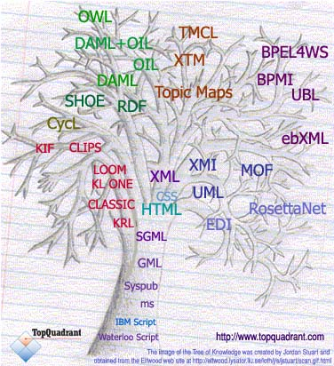
Tree of Knowledge Technologies
Content Management Languages
Semantic Technology Languages
Process Knowledge Languages
AI Knowledge Representation
Software Modeling Languages

Slide 64
Web Ontology Language
OWL (Version 1.0)

Slide 65
OWL became standard
10 February 2004 the World Wide Web Consortium announced final approval of two key Semantic Web technologies, the revised Resource Description Framework (RDF) and the Web Ontology Language (OWL).
Read more in:
http://www.w3.org/2004/01/sws-pressrelease.html.en

Slide 66
OWL Introduction
What is OWL?
  OWL is a language for defining Web Ontologies and their associated Knowledge Bases
  The OWL language is a revision of the DAML+OIL web ontology language incorporating learning from the design and application use of DAML+OIL.

Slide 67
OWL Introduction
DAML+OIL
  Extension of RDFS
  Allows machine understanding and automated reasoning.
    constraints on properties: exists, forall, cardinality
    boolean combination of classes and restrictions
    equivalence, disjointness
    covers necessary and sufficient condition
    constraints on properties
OWL Ontology Elements:
  Taxonomic relation between classes.
  Datatype properties, description of attributes of elements of classes,
  Object properties, description of relations between elements of classes.
  To a lesser extent includes
    Instances of classes
    Instances of properties

Slide 68
The Species of OWL
OWL Lite:
  Goal: to provide a language that is viewed by tool builders to be easy enough and useful enough to support.
  Captures many of the commonly used features of OWL and DAML+OIL.
  Describes a useful language that provides more than RDFS
  Provides a classification hierarchy and simple constraint features.
    E.g. Supports Cardinality constraints with values of 0 or 1.
OWL DL:
  Provides complete OWL vocabulary, interpreted under number of simple constraints.
    Primarily type separation
  Class identifiers cannot simultaneously be properties or individuals
  Properties cannot be individuals

Slide 69
The Species of OWL
OWL Full:
  Provides complete OWL vocabulary, interpreted more broadly than OWL DL, with the freedom provided by RDF.
  Class can be treated simultaneously as
    a collection of individuals (class extension)
    and as an individual in its own right (class intention)
  The Datatype property can be marked as InverseFunctionalProperty.

Slide 70
Changes from DAML+OIL
The namespace has been changed to http://www.w3.org/2002/07/owl
Updates from RDF and RDFs group have been introduced
  Cyclic subclasses are allowed
  multiple rdfs:domain and rdfs:range properties are handled as intersection
  rdf:parseType="Collection" replaces rdf:parseType="daml:collection"
  RDF Model Theory
  Datatypes?
Qualified restrictions were removed from the language, resulting in the removal of the following properties:
  daml:cardinalityQ
  daml:hasClassQ
  daml:maxCardinalityQ
  daml:minCardinalityQ
A few properties and classes have been renamed
    DAML+OIL OWL
    daml:differentIndividualFrom owl:differentFrom
    daml:hasClass owl:someValuesFrom
    daml:toClass owl:allValuesFrom
    daml:UnambiguousProperty owl:InverseFunctionalProperty
  daml:UniqueProperty owl:functionalProperty

Slide 71
Changes from DAML+OIL
For a DAML+OIL triple (S,P,0), if P is a uniqueProperty then S, the subject value, uniquely identifies O, the object value.
  Functional Property
    P(x,y) and P(x,z) -> y=z
    hasVintageYear (a wine has a unique vintage year)
For a DAML+OIL triple (S,P,0), If P is an UnambiguousProperty then O determines S.
  Inverse Functional Property
    P(y,x) and P(z,x) -> y=z
    hasMaker and producesWine are inverse functional
Universal Quantification (hasClass)
  allValuesFrom: For all wines, if they have makers, all the makers are wineries
Existential Quantification (toClass)
  someValuesFrom: For all wines, they have at least one maker that is a winery
owl:SymmetricProperty was added.
An owl:DatatypeProperty may be an owl:InverseFunctionalProperty in OWL Full.

Slide 72
Changes from DAML+OIL
Synonyms for RDF and RDF Schema classes and properties were removed from the language, resulting in the removal of:
  daml:comment
  daml:domain (owl:domain may still be required as non-synonym )
  daml:label
  daml:isDefinedBy
  daml:Literal
  daml:Property
  daml:range (owl:range may still be required as non-synonym)
  daml:seeAlso
  daml:subClassOf
  daml:subPropertyOf
  daml:type
  daml:value
daml:disjointUnionOf was removed from the language, since it can be effected using owl:unionOf or rdfs:subClassOf and owl:disjointWith.
daml:equivalentTo was renamed to owl:sameAs, and is no longer a superproperty of owl:sameClassAs, owl:samePropertyAs, and owl:sameIndividualAs

Slide 73
Feature Synopsis of OWL Lite & OWL Full
OWL Lite RDF Schema Features Synopsis
  Class
  rdf:Property
  rdfs:subClassOf
  rdfs:subPropertyOf
  rdfs:domain
  rdfs:range
  Individual
OWL Lite Equality and Inequality Synopsis
  sameClassAs
  samePropertyAs
  sameIndividualAs
  differentIndividualFrom
OWL Lite Property Characteristics Synopsis
  inverseOf
  TransitiveProperty
  SymmetricProperty
  FunctionalProperty (unique)
  InverseFunctionalProperty (unambiguous)
  allValuesFrom (universal local range restrictions; previously toClass)
  someValuesFrom (existential local range restrictions; previously hasClass)

Slide 74
Feature Synopsis of OWL Lite & OWL Full
OWL Lite Restricted Cardinality Synopsis
  minCardinality (restricted to 0 or 1)
  maxCardinality (restricted to 0 or 1)
  cardinality (restricted to 0 or 1)
OWL Class Axioms Synopsis
  oneOf (enumerated classes)
  disjointWith
  sameClassAs applied to class expressions
  rdfs:subClassOf applied to class expressions
OWL Boolean Combinations of Class Expressions Synopsis
  unionOf
  intersectionOf
  complementOf
OWL Arbitrary Cardinality Synopsis
  minCardinality
  maxCardinality
  cardinality
OWL Filler Information Synopsis
  hasValue Descriptions can include specific value information

Slide 75
OWL Example in Protégé (1)
Class
  Person superclass
  Man, Woman subclasses
Properties
  isWifeOf, isHusbandOf
Property characteristics, restrictions
  inverseOf
  domain
  range
  Cardinality
Class expressions
  disjointWith

Slide 76
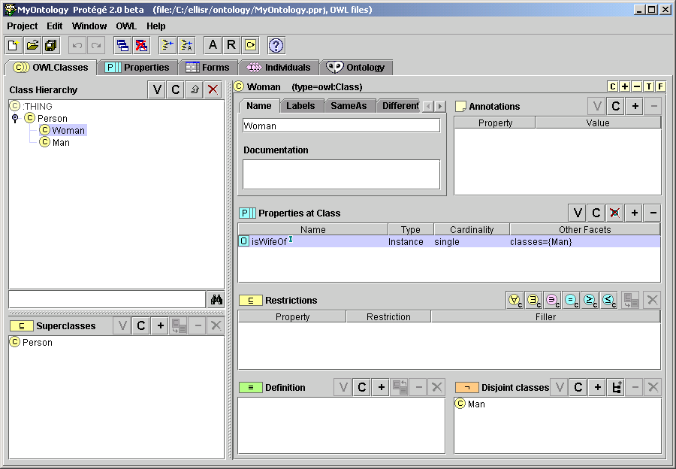
OWL Example in Protégé (2)

Slide 77
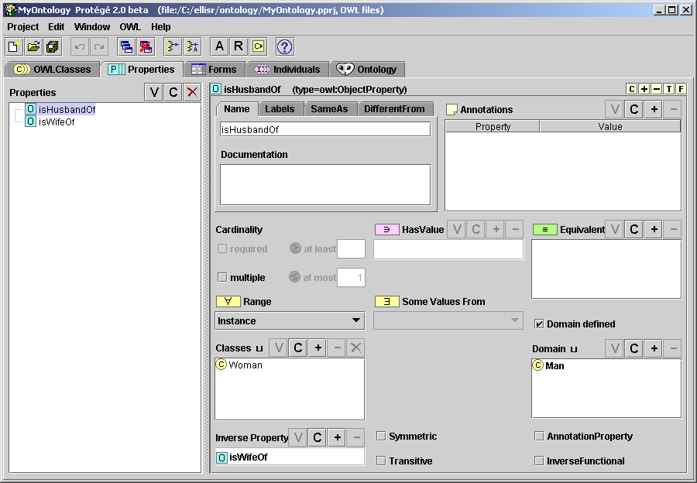
OWL Example in Protégé (3)

